Slide 1
What
Best Practices
Problems
Solutions
Singleton
MVC

Slide 2
Civil Engineering
Gang of four
Eric Gamma
Richard Helm
Ralph Johnson
John Vlissides

Slide 3
Solution
Problem
Context

Slide 4
Why
Capture design experience
Promote reuse without having to reinvent the wheel
Define the system structure better
Provide a common design language

Slide 5

How
Pattern
Catalog
Problem
Solution
Design Pattern
Candidate Pattern
Document
Problem
Solution

Slide 6
Pattern Catalog
GOF Pattern Catalog
JEE Pattern Catalog

Slide 7
GOF Pattern Catalog
Creational Patterns
Structural Patterns
Behavioral Patterns

Slide 8
Creational Patterns
Singleton
Factory
Abstract Factory
Builder
Prototype

Slide 9
Structural Patterns
Adapter
Bridge
Flyweight
Decorator
Proxy

Slide 10
Behavioral Patterns
Command
Interpreter
Template Method
Observer
Visitor

Slide 11



Java EE Pattern Catalog
Presentation Layer
Integration Layer
Service Layer
Data Access Layer

Slide 12
Presentation Layer
Intercepting Filter
Front Controller
MVC
Context Object

Slide 13
Business Layer
Business Delegate
Transer Object
Session Facade
Service Locator

Slide 14
Data Access Layer
Data Access Object
Integration Layer
Service Activator
Web Service Broker

Slide 15
Abstract Factory
Factory of Factories
JAXP
DocumentBuilderFactory
DocumentBuilder
Document

Slide 16
DAO Factory
Dao
DaoProducer
XMLEmpDao
DBEmpDao
DaoAbstractFactory
XMLDeptDao
DBDeptDao
XMLDaoFactory
DBDaoFactory

Slide 17
DAO
EmployeeDAO
Employee
DB
EmployeeDAOImpl
create

Slide 18
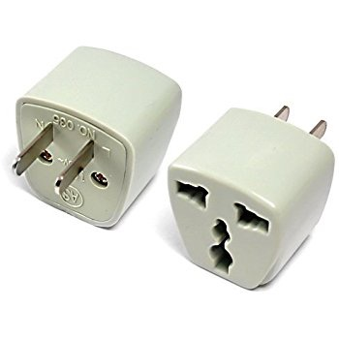
Adapter

Slide 19
WeatherFinder
find(city)
WeatherAdapter
WeatherUI
findTemperature(zipcode)
zipcode
WeatherFinderImpl
find(city)

Slide 20
Behavioral Pattern
Client
Invoker
Command
Receiver
ConcreteCommand

Slide 21
Command
Person
RemoteControl
pressButton()
Command
execute()
Television
OnCommand
OffCommand
on()
execute()
execute()
off()

Slide 22
Decorator
Functionality at runtime
new BufferedReader(new FileReader(..));
Reader

Slide 23
Client
ConcreteDecorator
VeggiePizzaDecorator
Decorator
Pizza pizza;
Pizza
PizzaDecorator
Component
CheesePizzaDecorator
PlainPizza
Pizza pizza;
ConcreteComponent

Slide 24
Factory
Hides the object creation process
Car Factory
Chocolate Factory
Toy Factory

Slide 25
Connection connection =
DriverManager.getConnection(String conString)
Oracle
Driver
MySql
Sql Server

Slide 26
Pizza Store
PizzaStore
Pizza
PizzaFactory
prepare
bake
cut
VegPizza
CheesePizza
MeatPizza

Slide 27
Flyweight
Save Memory

Slide 28
Paint App
Shape
draw()
Circle
Rectangle
length
radius
breadth
draw()
draw()

Slide 29
Separate the Extrinsic State
Pass them as parameters
Create a factory class

Slide 30
Key Points
Memory Foot Print
Non Sharable state as parameters
Create a factory class
Make the Clients Use it

Slide 31
Paint App
Shape
draw()
Circle
Rectangle
draw()
draw()

Slide 32
Separate the Extrinsic State
Pass them as parameters
Create a factory class

Slide 33
Dependency Injection
Inversion Of Control
A
B
HAS-A
AImpl
BImpl
B b = new BImpl();
Spring Container

Slide 34
Interceptor Filter
Presentation Layer
Front Controller
MVC
Service Layer
Business Delegate
Business Object
Data Access Object
Data Access Layer

Slide 35
Singleton
ONE AND ONLY ONE
Logger
Class 1
Properties File
error
debug
PropertyReader
info
Class 2

Slide 36
Steps
Declare the constructor of the class as private
Declare a static method
Declare a static member of the same class
type in the class

Slide 37
Template Method
DataRenderer
render()
readData()
processData()
XMLDataRenderer
CSVDataRenderer
readData()
readData()
processData()
processData()

Slide 38
Prototype

Slide 39
O1
State/Data
Gaming
App
O2
State/Data
O3
State/Data

Slide 40
Singleton
O1
Spring
O2
Prototype
O3

Slide 41
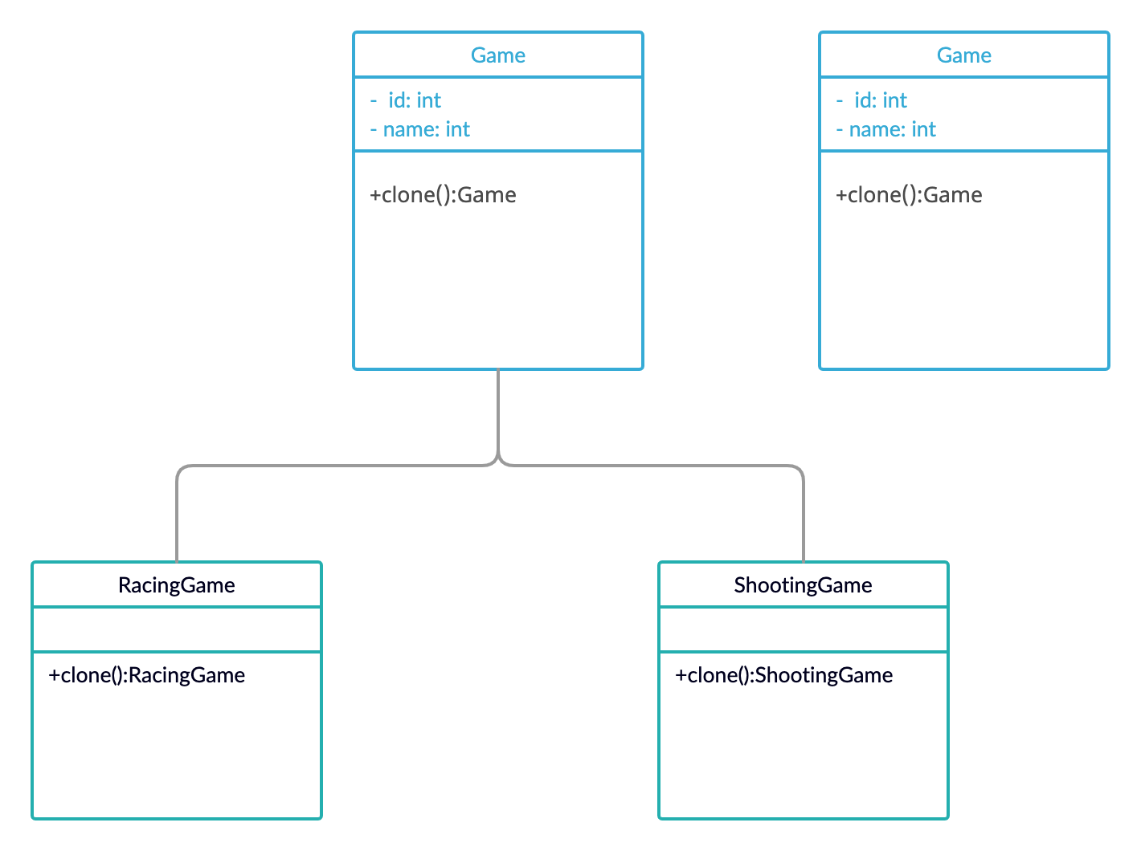

Slide 42
Facade
CheckStock
Client
PlaceOrder
ShipOrder

Slide 43
CheckStock
Client
Facade
PlaceOrder
EJB/RPC
REST
ShipOrder

